Slide 1

Presented By
Amit Kumar
PRACTICAL SUBMISSION
INTRODUCTION TO DATASCIENCE
Presented By
Amit Kumar
Presented To
Mrs.Neema Jha
(Assistant Professor)

Slide 2



Introduction to
DATA SCIENCE

Slide 3

Content
What is Data Science & Application
Data Science Process
Data Mining
Big Data
PRACTICAL EXCEL

Slide 4


What is Data Science ?
Data Science is the process of extracting Knowledge and insights from data by using scientific method.

Slide 5

APPLICATION OF DATA SCIENCE
Sports

Slide 6
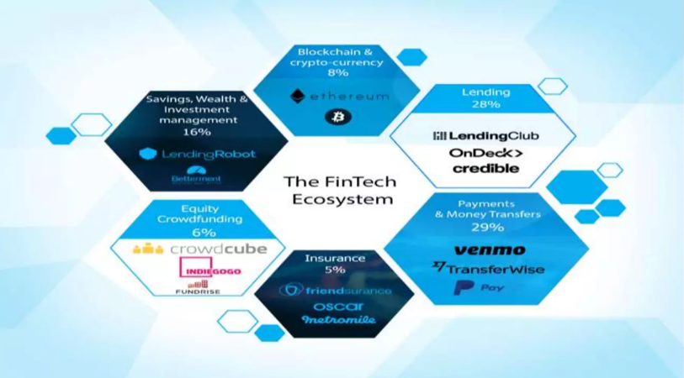
APPLICATION OF DATA SCIENCE
Banking and Finance

Slide 7
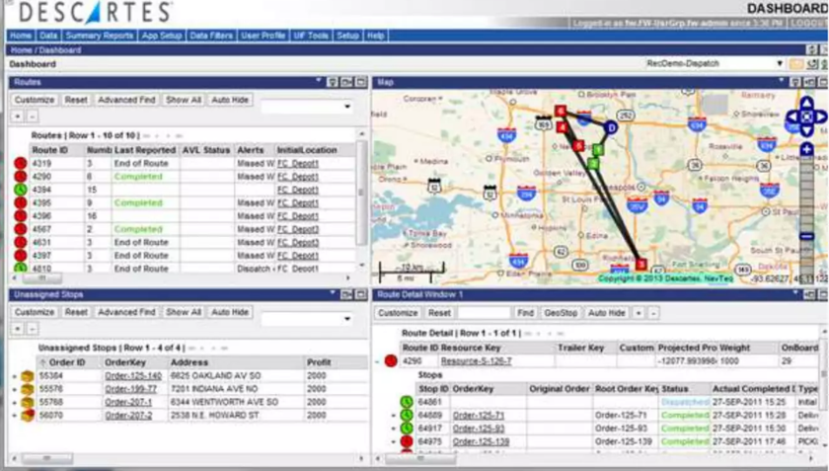
APPLICATION OF DATA SCIENCE
Airline Route Planning

Slide 8

APPLICATION OF DATA SCIENCE
Fraud and Detection

Slide 9
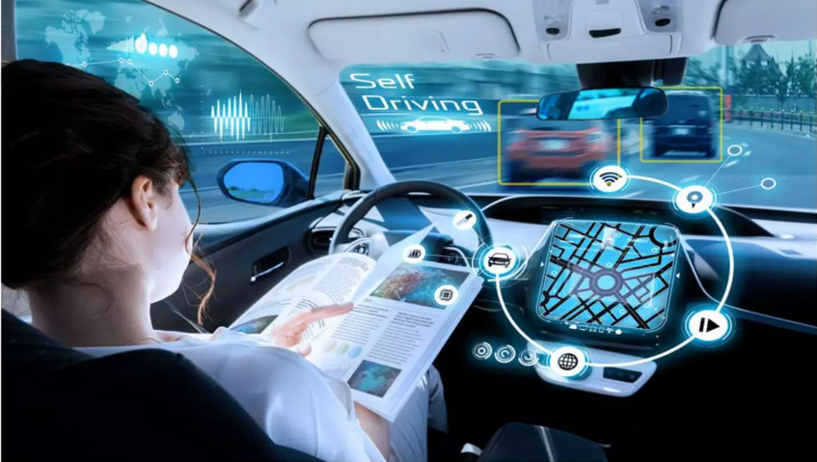
APPLICATION OF DATA SCIENCE
Self-Driving car

Slide 10
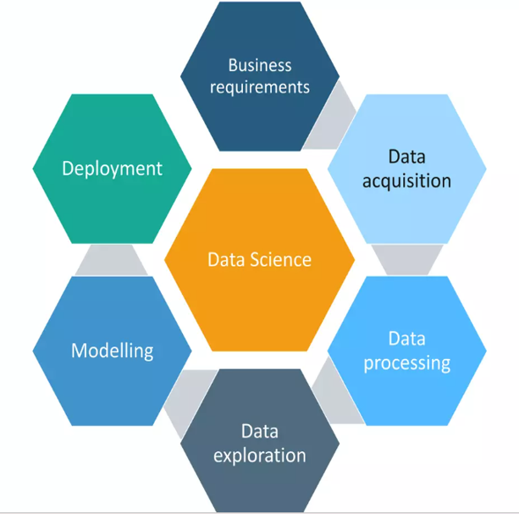
Data Life Cycle

Slide 11
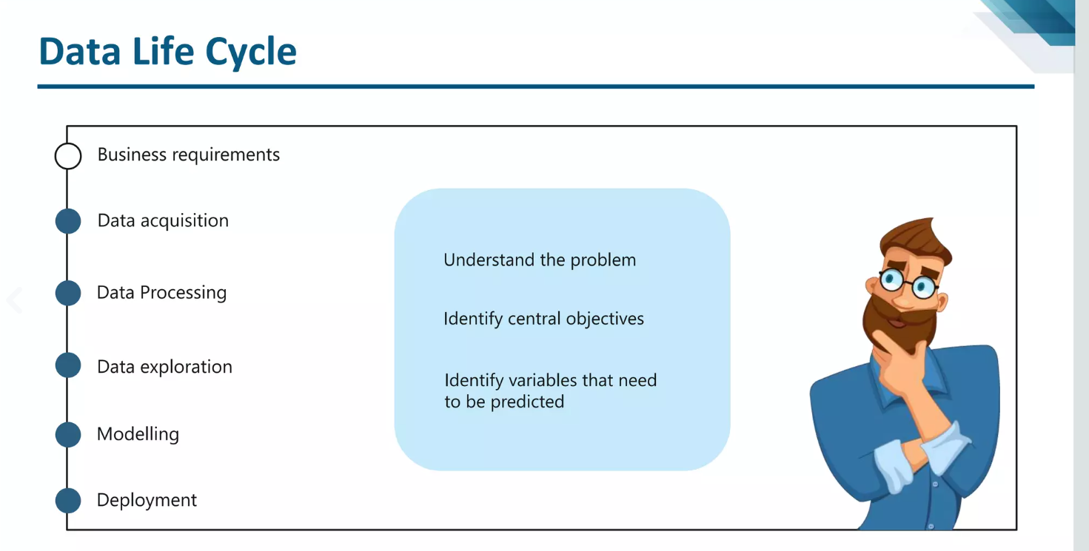

Slide 12
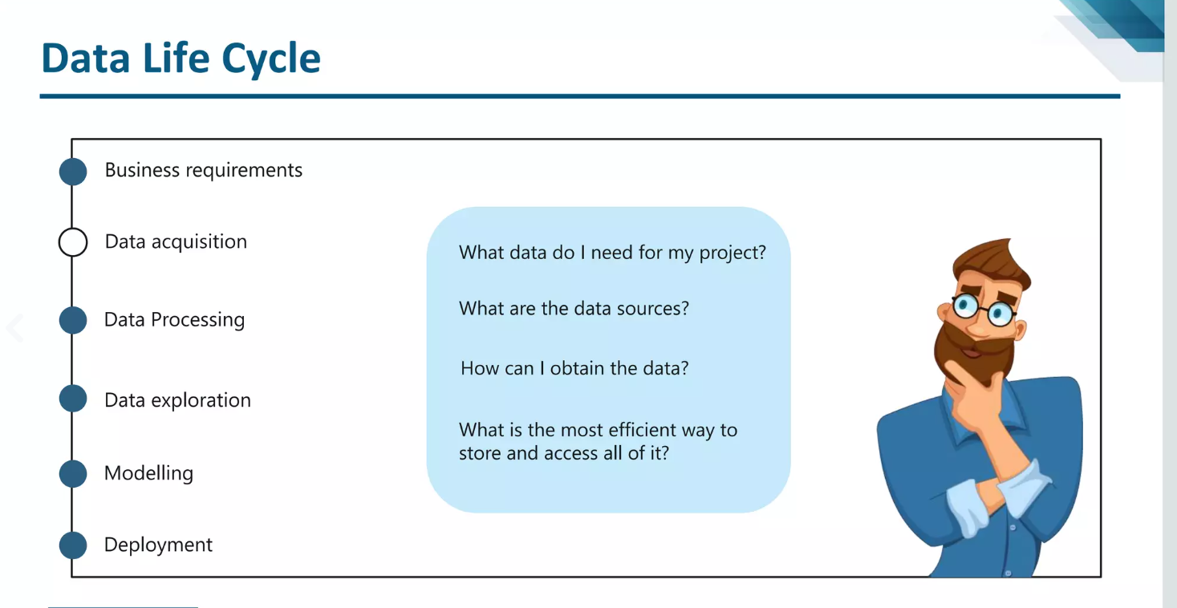

Slide 13
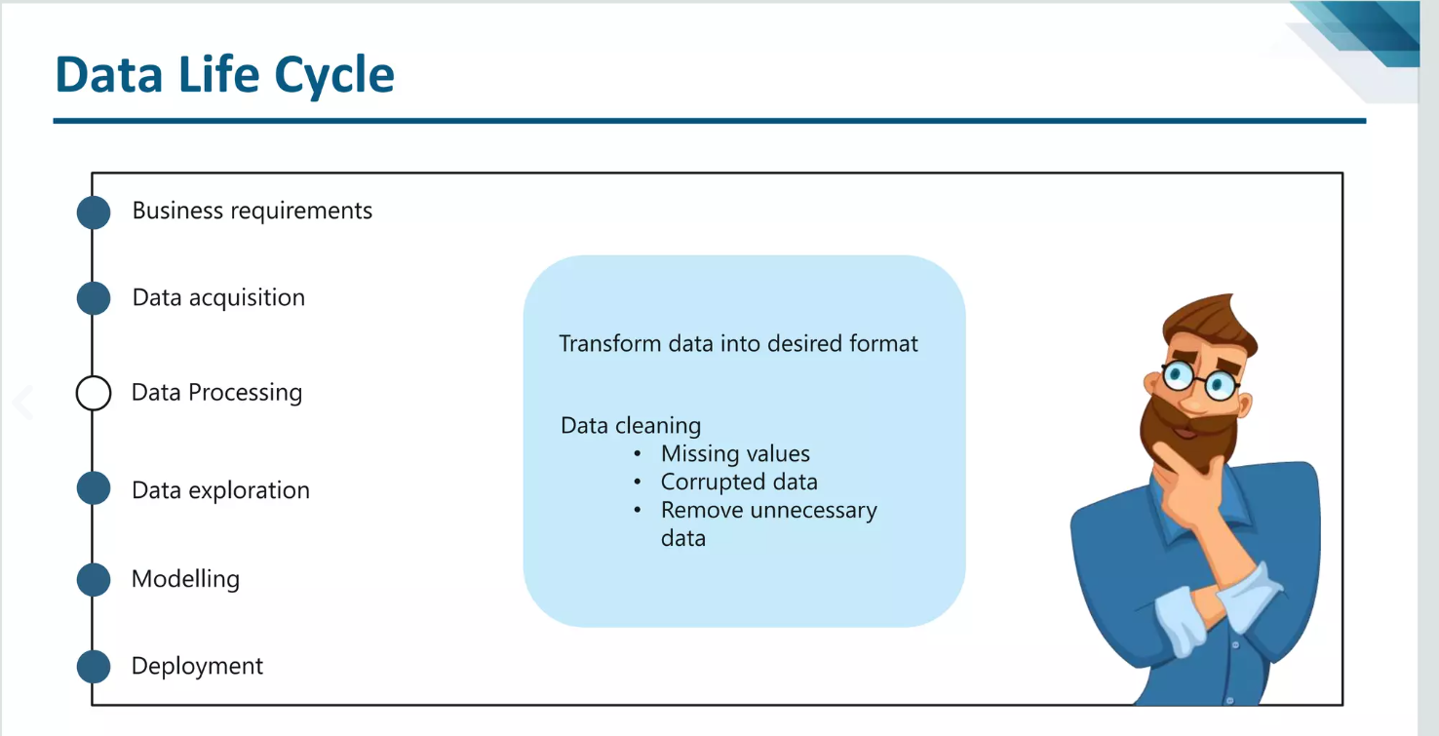

Slide 14
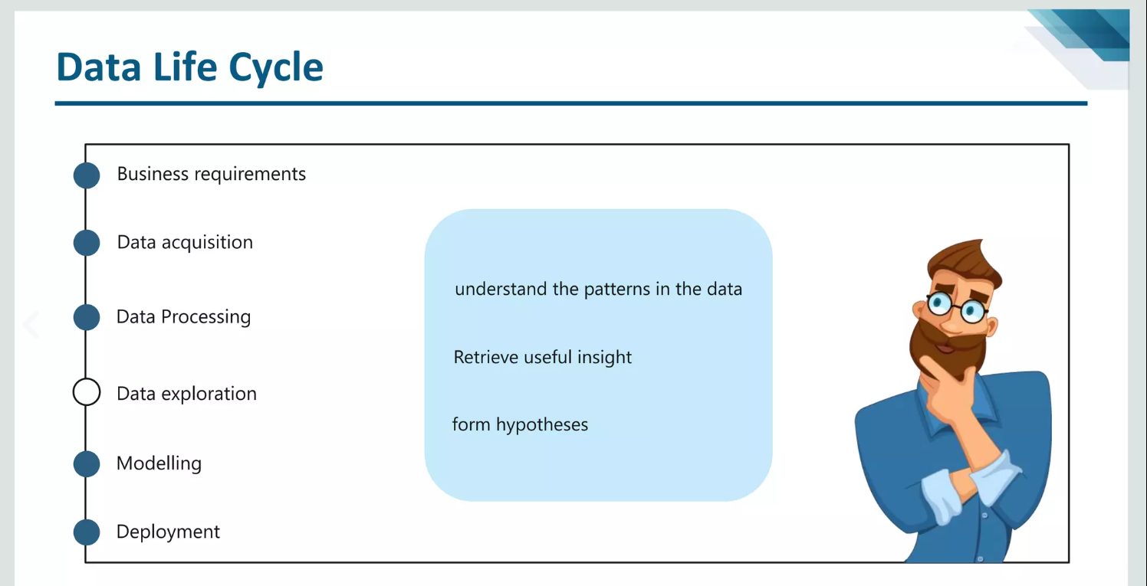

Slide 15
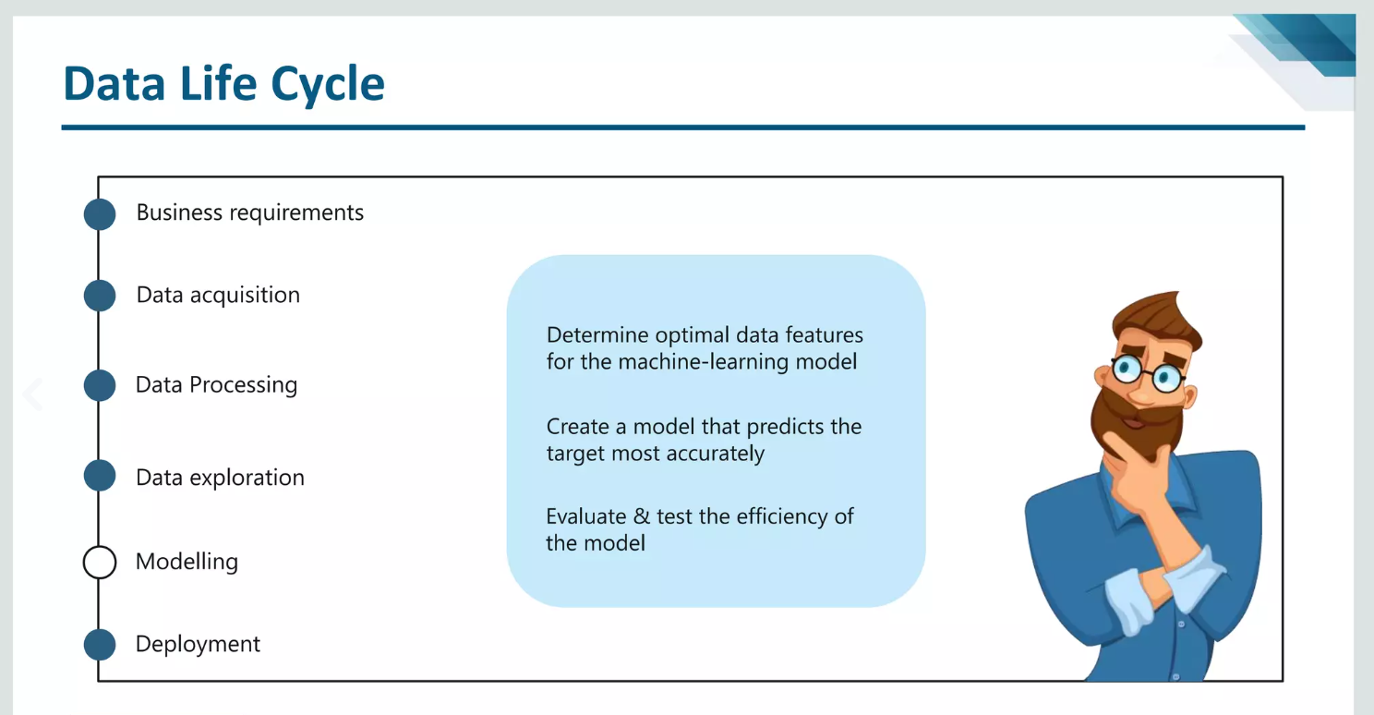

Slide 16
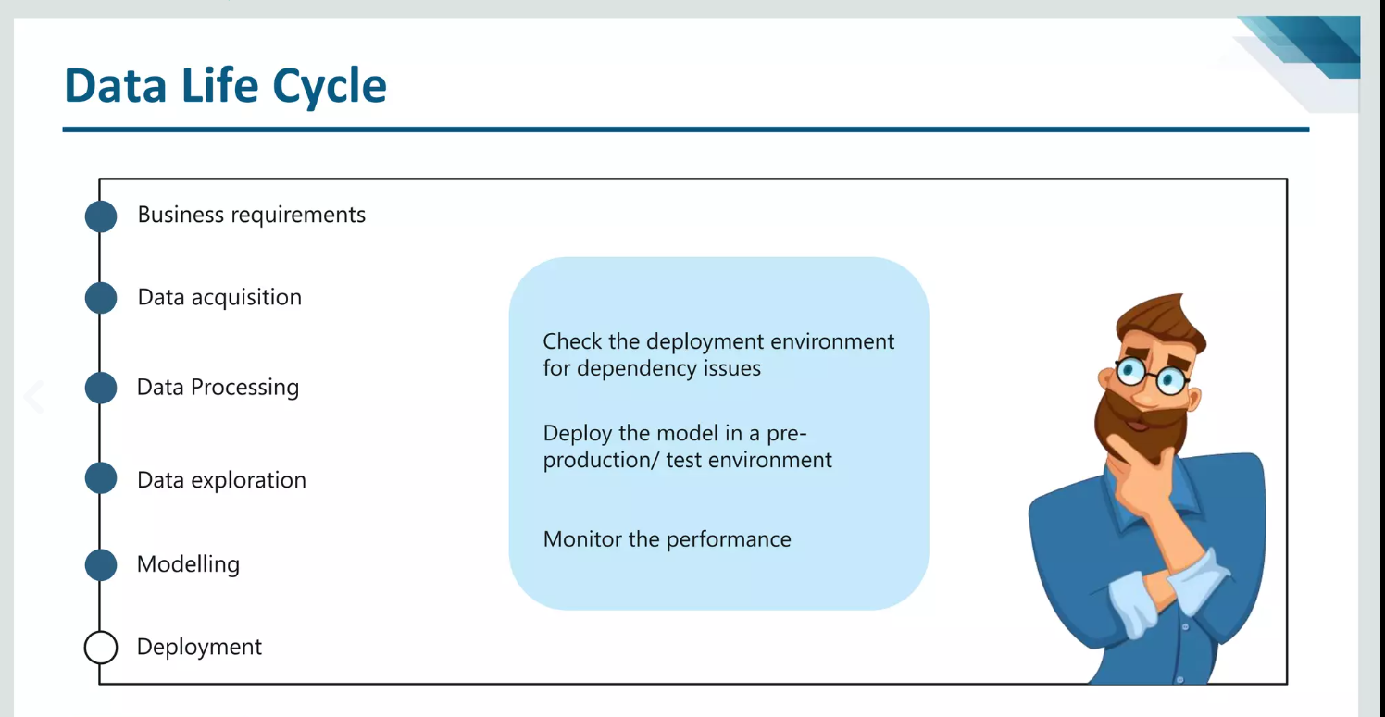

Slide 17
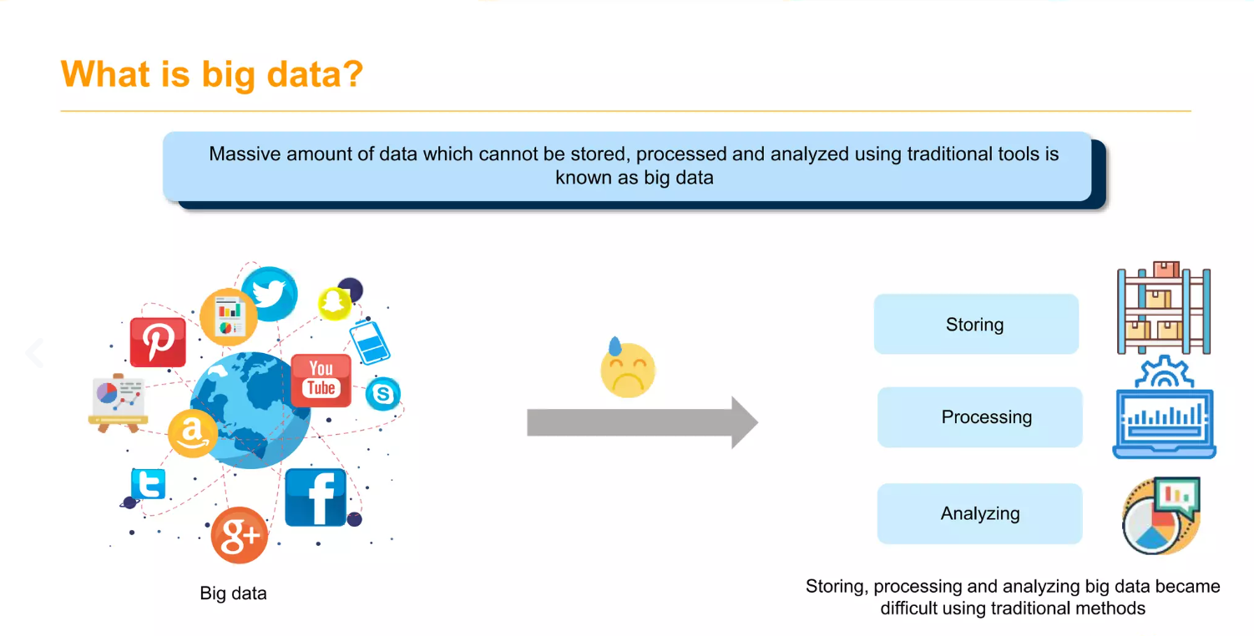

Slide 18

Example of Big Data

Slide 19
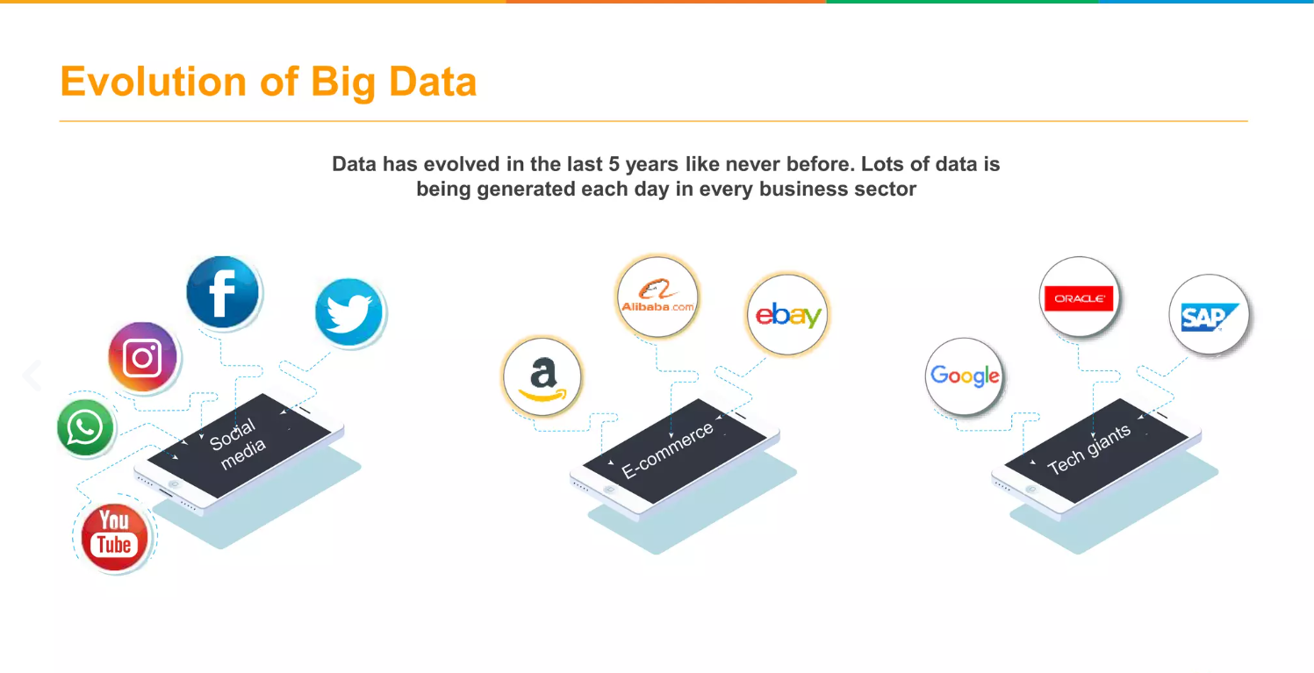

Slide 20
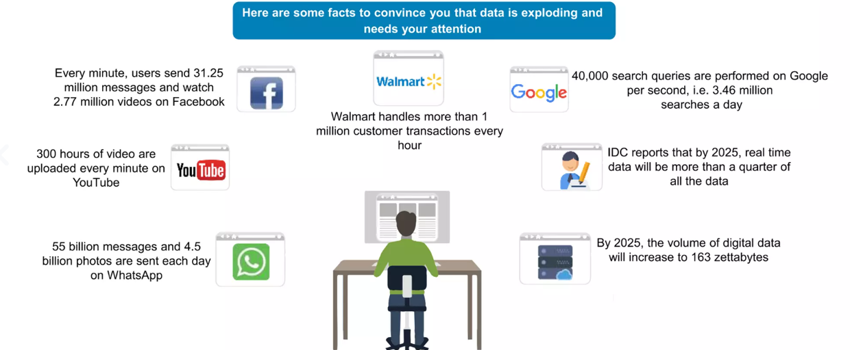

Slide 21
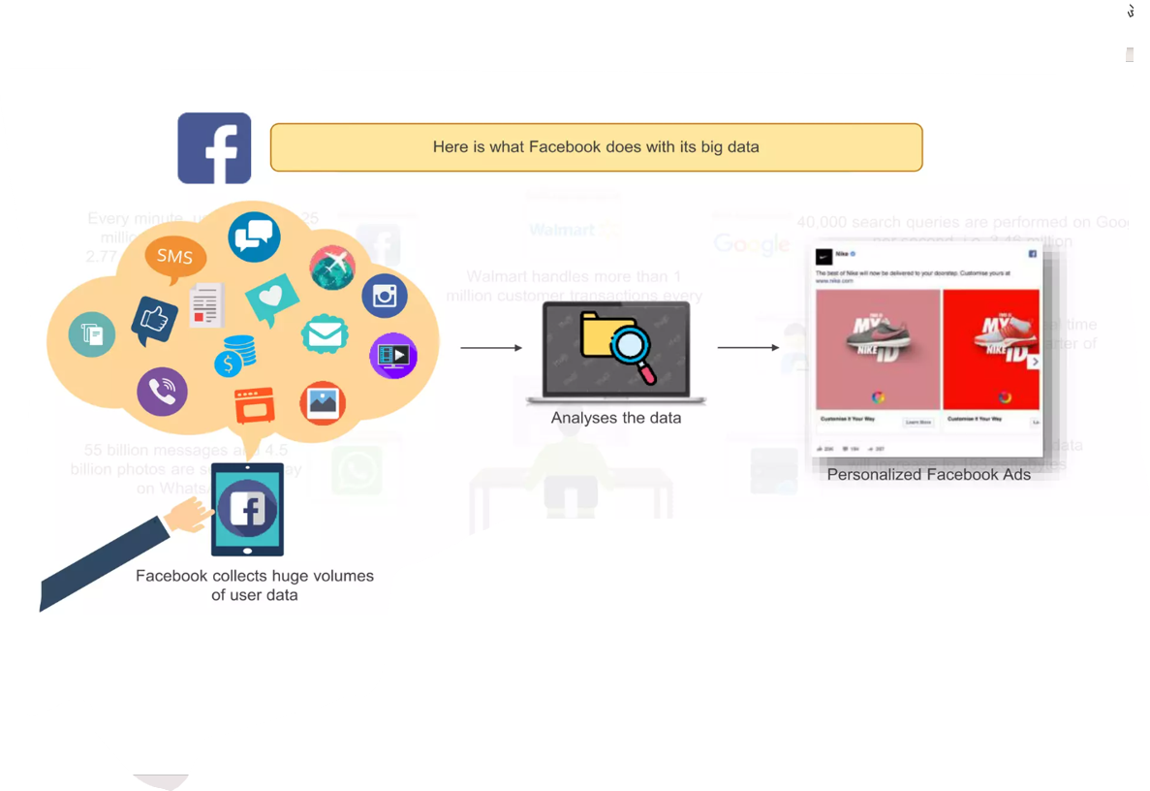

Slide 22

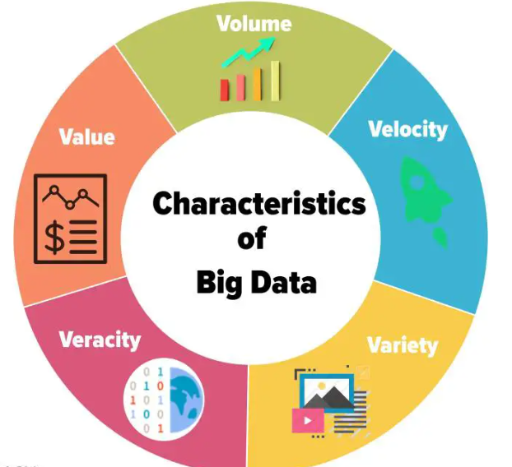

Slide 23
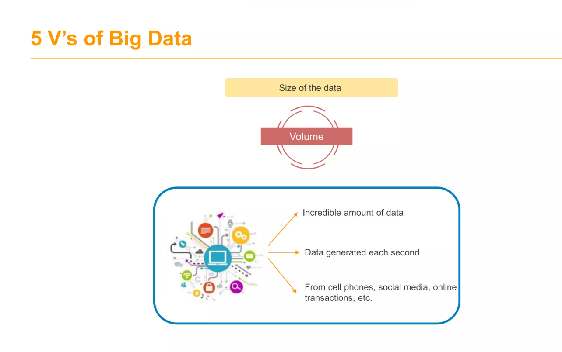

Slide 24
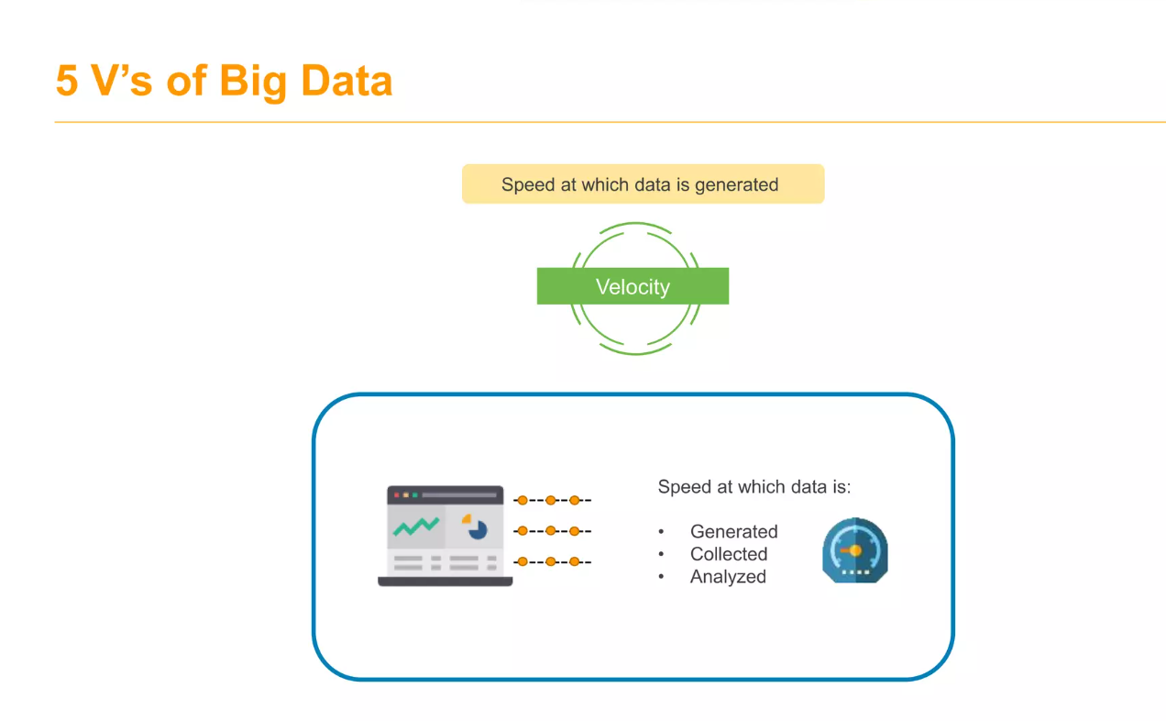

Slide 25
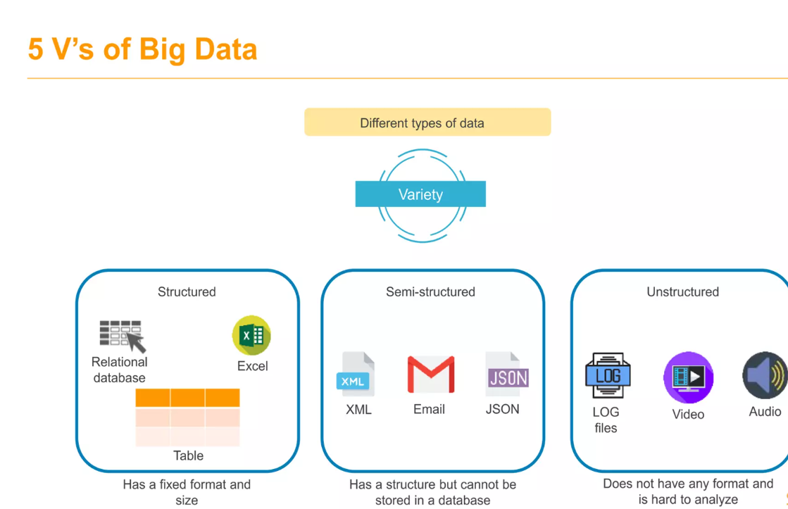

Slide 26
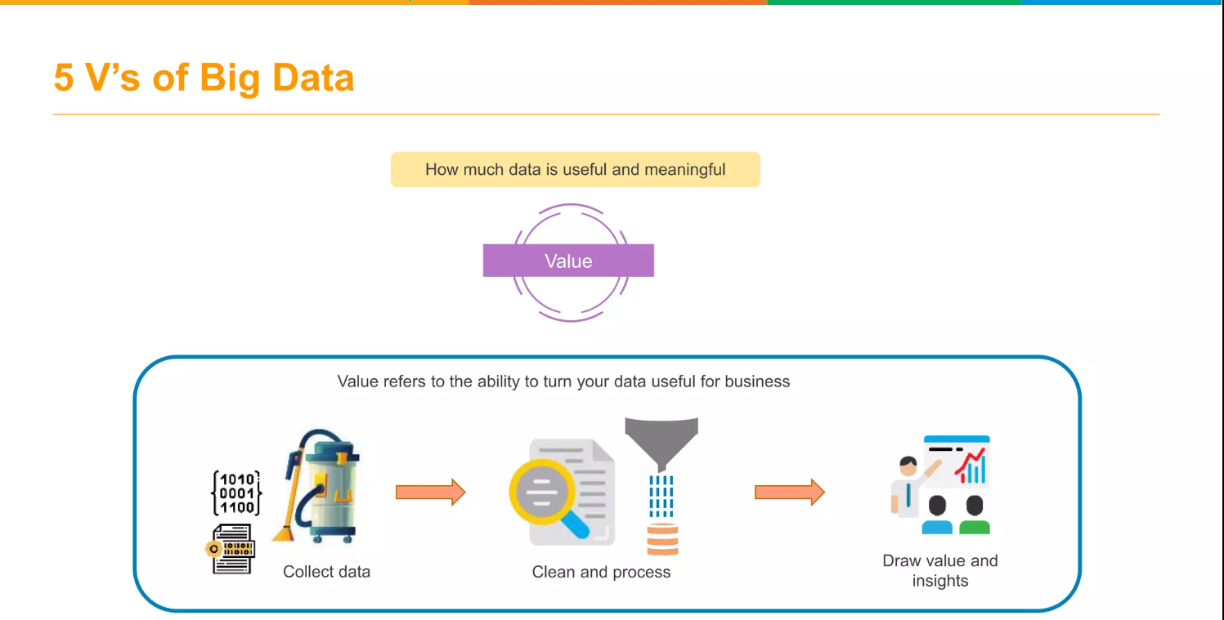

Slide 27
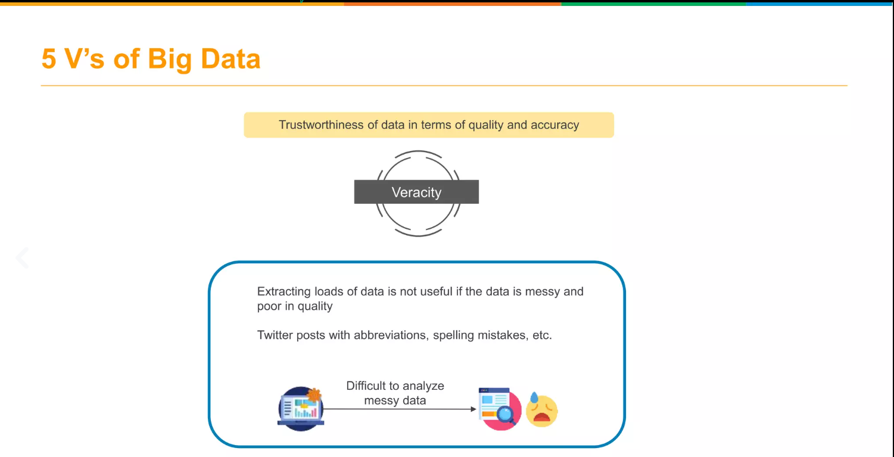

Slide 28
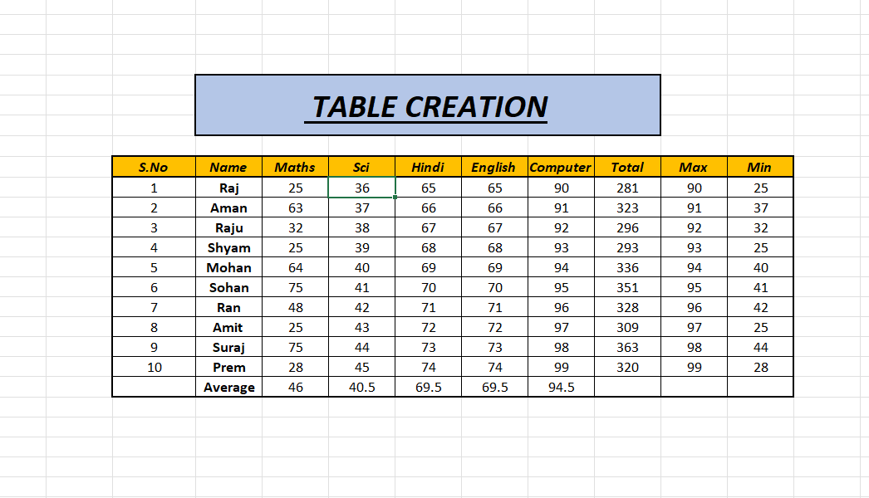
Excel Practical

Slide 29
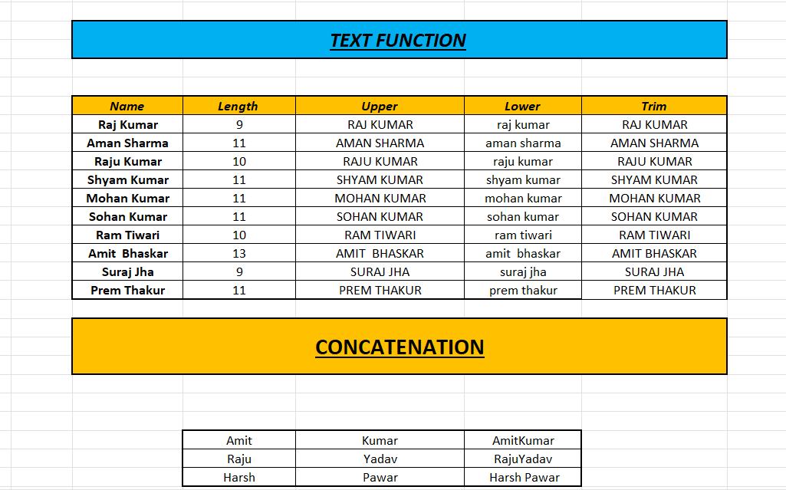

Slide 30
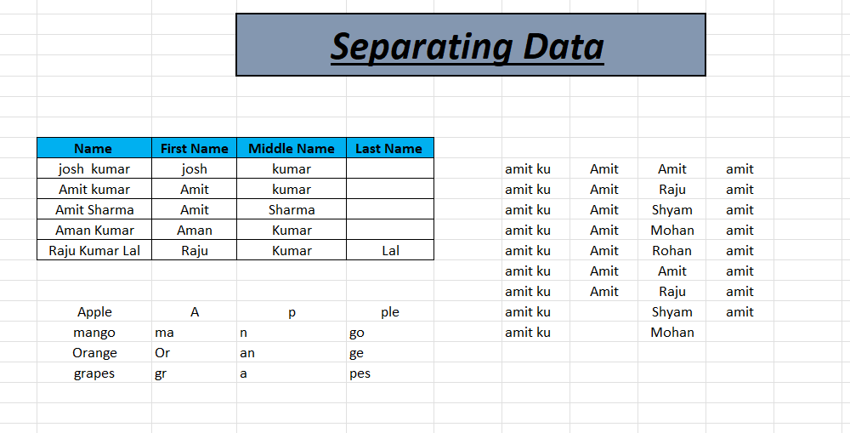
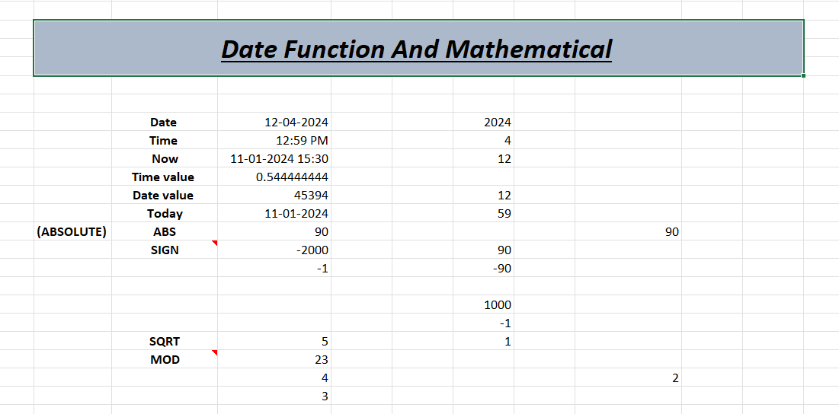

Slide 31
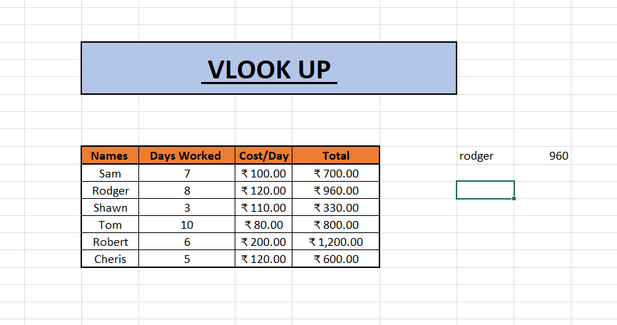
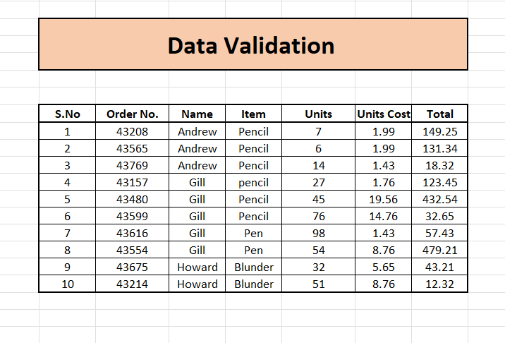

Slide 32
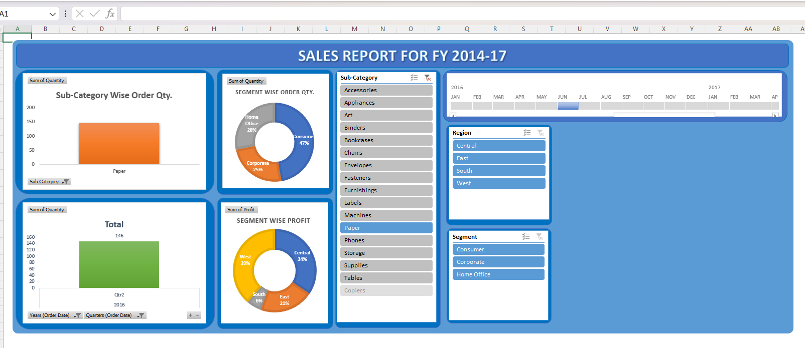
Dashboard

Slide 33



